Slide 1
4-3: Change your thoughts, change your life
By Barbara Oakley, PhD

Slide 2
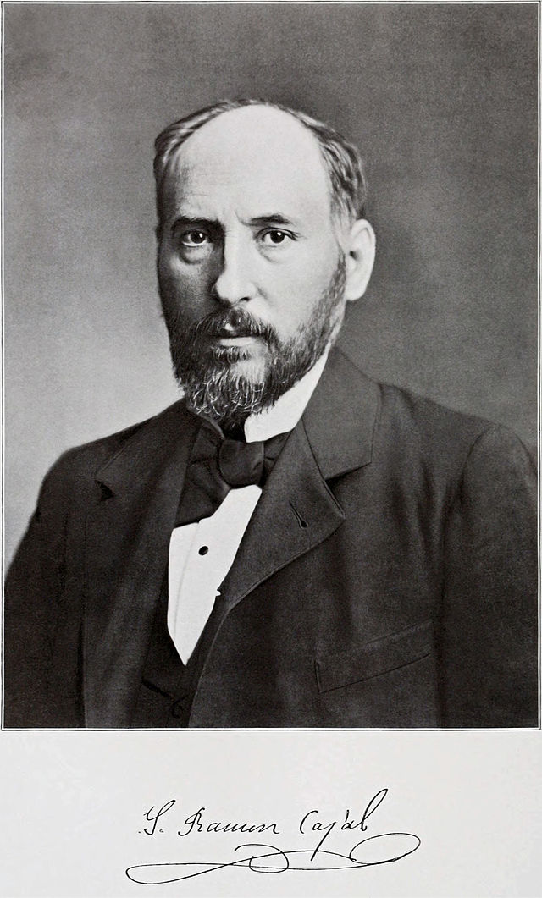
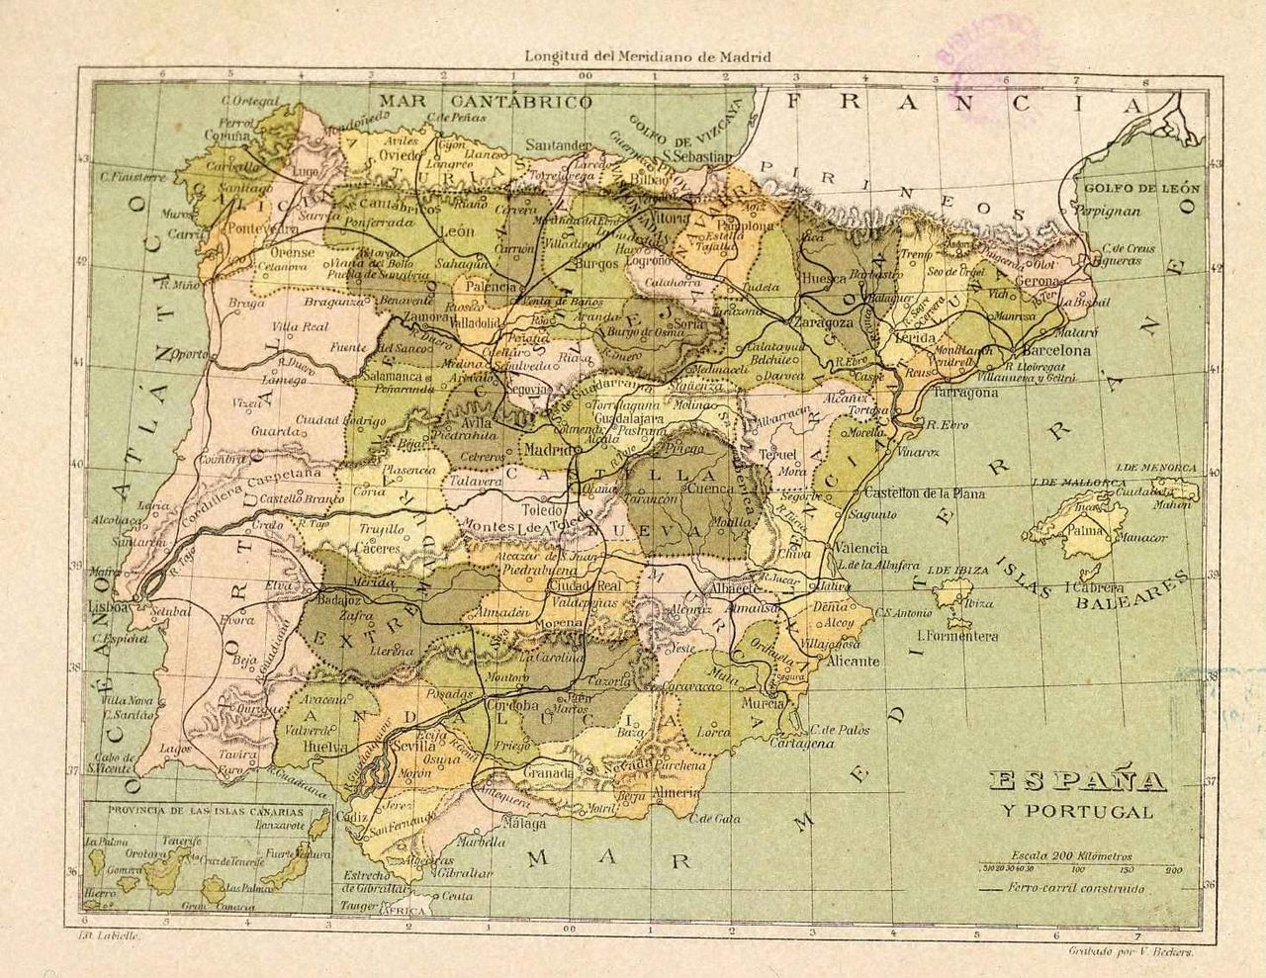

Slide 3
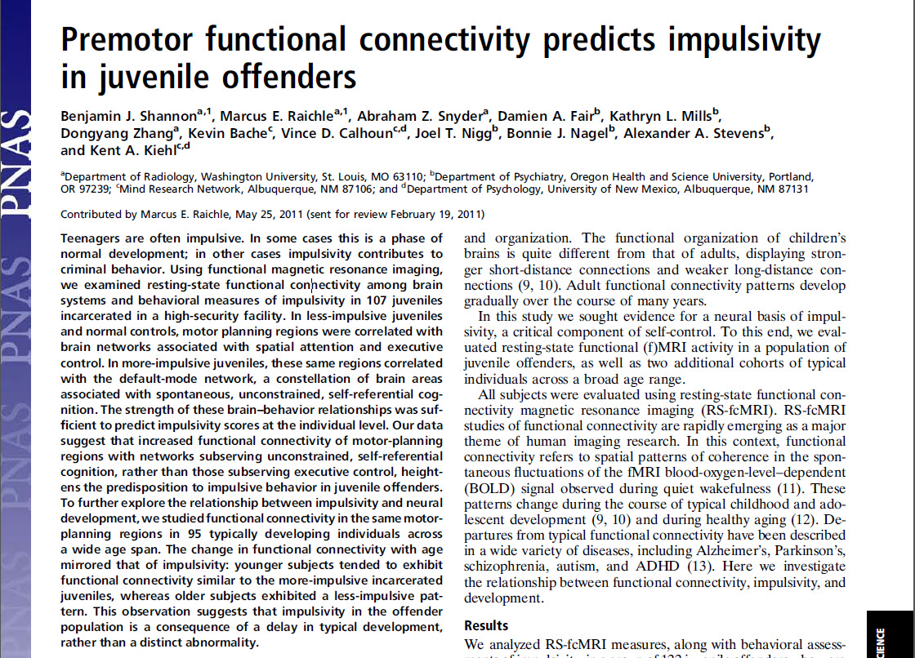

Slide 4
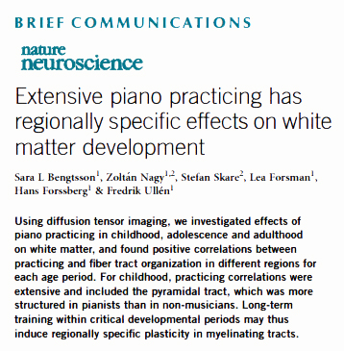
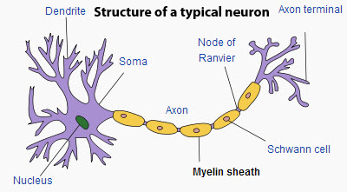

Slide 5
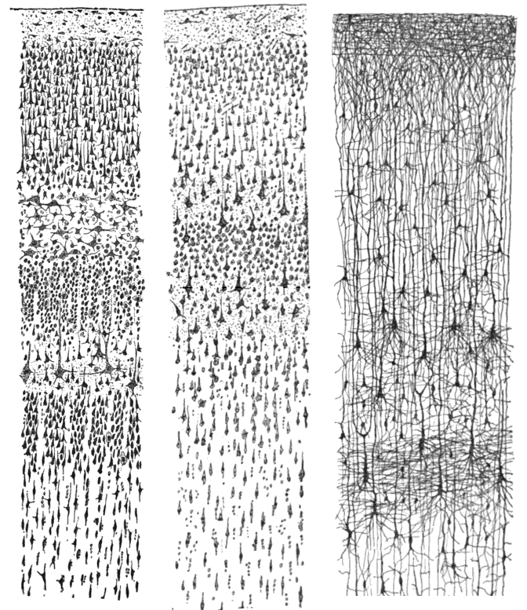
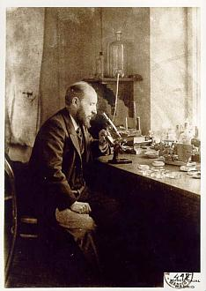
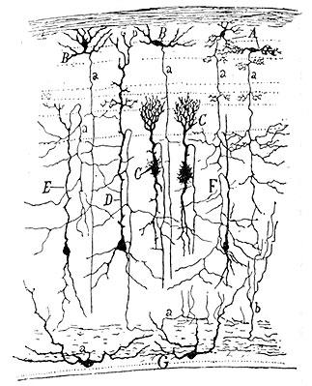
Comparative study of the sensory areas
of the human cortex, hand drawn by
Santiago Ramón y Cajal, 1899
Drawing of a section through the
optic tectum of a sparrow, hand drawn by
Santiago Ramón y Cajal, 1905

Slide 6
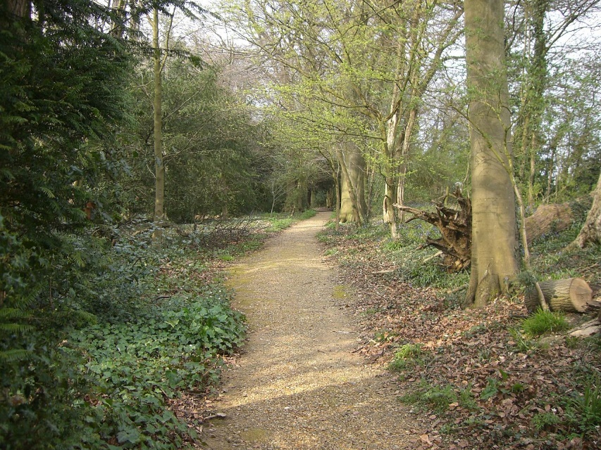
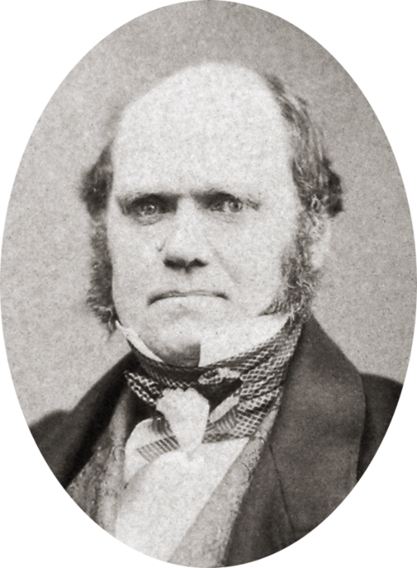
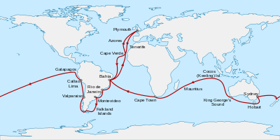
A path in the grounds of Down House.
Darwin regularly walked along this path
for exercise of body and mind.
He called it his "Thinking Path."
The voyage of the
Beagle, 1831 - 1836
Charles Darwin, aged 46 in 1855,

Slide 7
Illustration credits
España provincial 1850Public Domain, http://en.wikipedia.org/wiki/Mid-nineteenth_century_Spain#mediaviewer/File:Espa%C3%B1a_provincial_1850.jpg
Anonymous photo of Santiago Ramón y Cajal published by Clark University in 1899. http://en.wikipedia.org/wiki/Santiago_Ram%C3%B3n_y_Cajal#mediaviewer/File:Cajal-Restored.jpg
Shannon, B. J., M. E. Raichle, A. Z. Snyder, D. A. Fair, K. L. Mills, D. Zhang, K. Bache, et al. "Premotor Functional Connectivity Predicts Impulsivity in Juvenile Offenders." PNAS 108, no. 27 (Jul 5 2011): 11241-5.
Bengtsson, Sara L, Zoltán Nagy, Stefan Skare, Lea Forsman, Hans Forssberg, and Fredrik Ullén. "Extensive Piano Practicing Has Regionally Specific Effects on White Matter Development." Nature Neuroscience 8, no. 9 (2005): 1148-50.
Structure of typical neuron, http://en.wikipedia.org/wiki/Myelin, Original uploader was Quasar Jarosz.
Santiago Ramón y Cajal in his laboratory, http://en.wikipedia.org/wiki/Santiago_Ram%C3%B3n_y_Cajal#mediaviewer/File:Cajal-mi.jpg
Three drawings by Santiago Ramon y Cajal, taken from the book "Comparative study of the sensory areas of the human cortex", pages 314, 361, and 363, http://en.wikipedia.org/wiki/Santiago_Ram%C3%B3n_y_Cajal#mediaviewer/File:Cajal_cortex_drawings.png
Drawing of a section through the optic tectum of a sparrow, by Santiago Ramón y Cajal from "Estructura de los centros nerviosos de las aves", Madrid, 1905. http://en.wikipedia.org/wiki/Santiago_Ram%C3%B3n_y_Cajal#mediaviewer/File:SparrowTectum.jpg
Charles Darwin by Maull and Polyblank, 1855-crop, http://en.wikipedia.org/wiki/Charles_Darwin#mediaviewer/File:Charles_Darwin_by_Maull_and_Polyblank,_1855-crop.png
Voyage of the Beagle-en Sémhur - Image:Voyage of the Beagle.jpg by Kipala, Samsara and Dave souza, from a map by User:WEBMASTER, under licence CC-BY-SA. http://en.wikipedia.org/wiki/Charles_Darwin#mediaviewer/File:Voyage_of_the_Beagle-en.svg
Photo by Tedgrant: A path in the grounds of Down House. Darwin regularly walked along this path for exercise of body and mind. He called it his "Thinking Path". http://en.wikipedia.org/wiki/Charles_Darwin#mediaviewer/File:Darwins_Thinking_Path.JPG

Slide 8
Relevant Readings
Armstrong, J Scott. "Natural Learning in Higher Education." In Encyclopedia of the Sciences of Learning, 2426-33: Springer, 2012.
Bengtsson, Sara L, Zoltán Nagy, Stefan Skare, Lea Forsman, Hans Forssberg, and Fredrik Ullén. "Extensive Piano Practicing Has Regionally Specific Effects on White Matter Development." Nature Neuroscience 8, no. 9 (2005): 1148-50.
Colvin, Geoff. Talent Is Overrated. NY: Portfolio, 2008.
DeFelipe, Javier. "Brain Plasticity and Mental Processes: Cajal Again." Nature Reviews Neuroscience 7, no. 10 (2006): 811-17.
———. "Sesquicentenary of the Birthday of Santiago Ramón Y Cajal, the Father of Modern Neuroscience." Trends in Neurosciences 25, no. 9 (2002): 481-84.
DeFelipe, Javier Cajal's Butterflies of the Soul: Science and Art [in English Action Note: Actions: cat Interval: 20090415 Agent: asg/mpl MARC code of institution: BUPB]. NY: Oxford University Press, 2010.
Doidge, N. The Brain That Changes Itself. NY: Penguin, 2007.
Fields, R Douglas. "White Matter in Learning, Cognition and Psychiatric Disorders." Trends in Neurosciences 31, no. 7 (2008): 361-70.
McCord, Joan. "A Thirty-Year Follow-up of Treatment Effects." American Psychologist 33, no. 3 (1978): 284.
Oakley, Barbara A. "Concepts and Implications of Altruism Bias and Pathological Altruism." Proceedings of the National Academy of Sciences 110, no. Supplement 2 (2013): 10408-15.
Ramón y Cajal, Santiago. Advice for a Young Investigator. Translated by Neely Swanson and Larry W. Swanson. Cambridge, MA: MIT Press, 1999 [1897].
———. Recollections of My Life. Cambridge, MA: MIT Press, 1937. Originally published as Recuerdos De Mi Vida in Madrid, 1901-1917, translated by Craigie, E. Horne.
Shannon, B. J., M. E. Raichle, A. Z. Snyder, D. A. Fair, K. L. Mills, D. Zhang, K. Bache, et al. "Premotor Functional Connectivity Predicts Impulsivity in Juvenile Offenders." PNAS 108, no. 27 (Jul 5 2011): 11241-5.
Shaw, Christopher A., and Jill C. McEachern, eds. Toward a Theory of Neuroplasticity. NY: Psychology Press, 2001.
Sherrington, C. S. "Santiago Ramon Y Cajal 1852-1934." Biographical Memoirs of Fellows of the Royal Society 1, no. 4 (1935): 424-44.
Spear, Linda Patia. "Adolescent Neurodevelopment." Journal of Adolescent Health 52, no. 2 (2013): S7-S13.
Thomas, C., and C. I. Baker. "Teaching an Adult Brain New Tricks: A Critical Review of Evidence for Training-Dependent Structural Plasticity in Humans." [In eng]. NeuroImage 73 (Jun 2013): 225-36.

